Slide 1

Privacy - Preserving
AI
for Phishing Detection
Presented by
Shruthi Manchappanahalli Basavaraj,
Sri Sakticharan Nirmal Kumar,
Saptharish Golagani,
Siva Satya Dheeraj Varma Sreevatsavaya.
Mentor: Prof. Jerry Cheng

Slide 2

Project Motivation
Rising Threat
Phishing exploits emails, fake websites, and brand images.
Multimodal Nature
Phishing involves multiple input types, not just one.
Privacy Risk
Centralized detection compromises user data privacy.
Need
Secure, scalable detection across all phishing formats.

Slide 3

Project Objectives & Goals
Multimodal Detection
Fusion Learning
Collaborative Model
Training
Scalable Architecture
Integrate email, URL, and image classifiers.
Improve precision and recall using soft voting classifier
Train the best model using Federated Learning — clients train locally, and the server combines the results to build a best model.
Modular system adaptable to future modalities like SMS and social media.

Slide 4
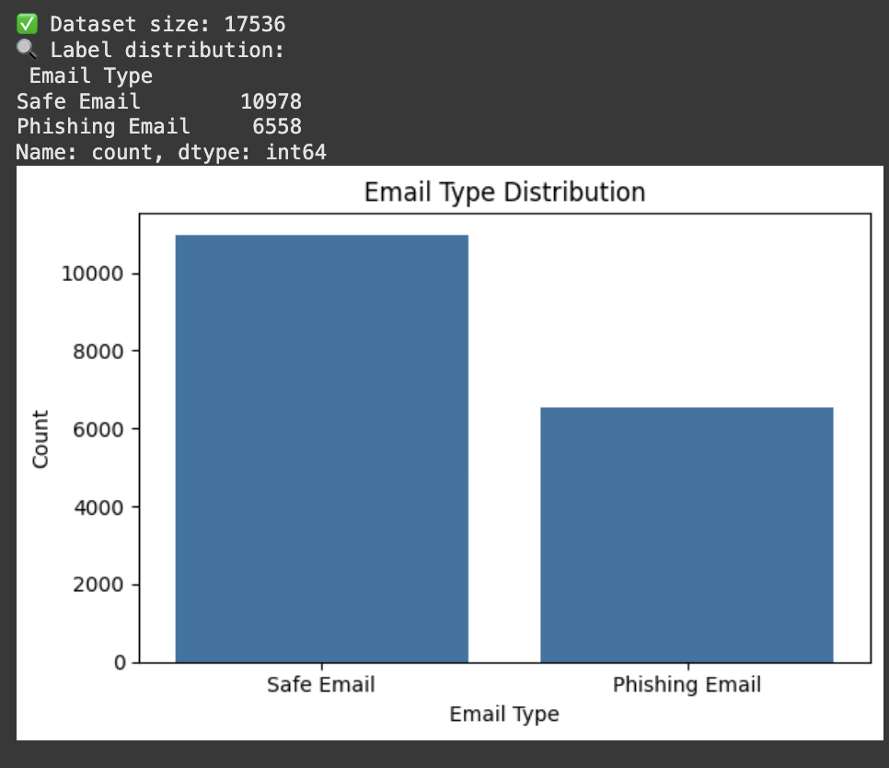
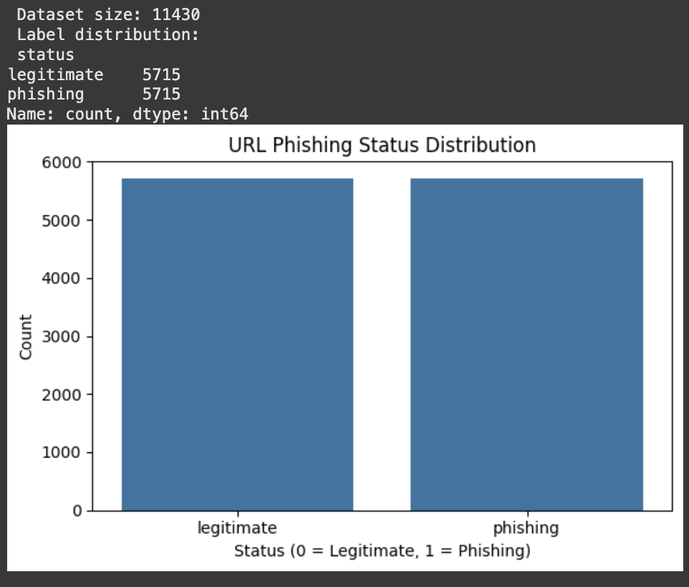
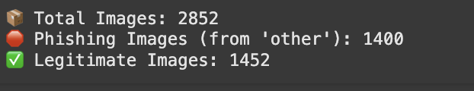
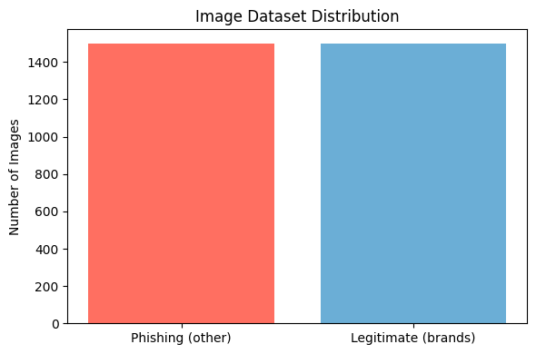
Dataset Overview
Email Dataset
URL Dataset
Image Dataset
Source: Open dataset containing labeled phishing and legitimate emails
11,400+ phishing and legitimate URLs
~2,500 webpage screenshots
Features: length, special chars, suspicious keywords
https://www.phishtank.com/index.php
Resized, normalized, augmented images
https://www.kaggle.com/datasets/saurabhshahane/pishiris
Size: 17,000+ * 2 samples
https://github.com/AkashSavanur/Phishing-Email-Detection/blob/main/Phishing.csv.zip

Slide 5
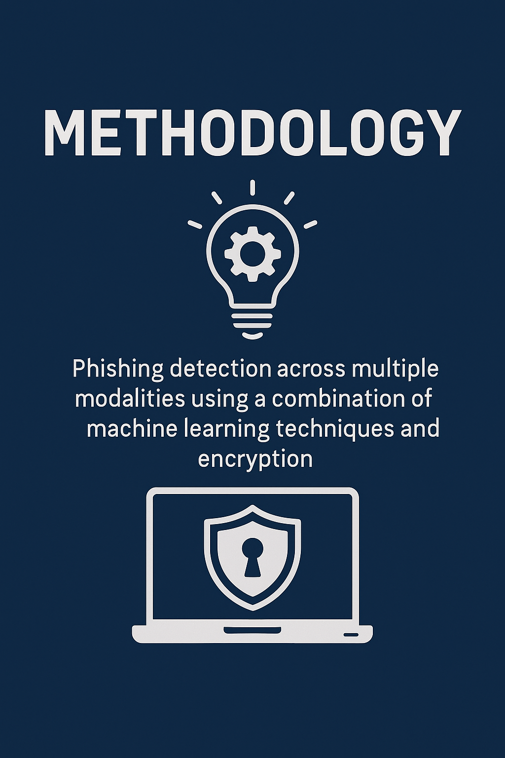





Methodology Overview
Input Types
Email
URL
Webpage Image
Preprocessing
Text cleaning, feature extraction
Image resizing, normalization
Model Training
Multiple models per modality trained individually
Fusion
Soft voting per modality, hard voting final decision
Multimodal Model
Final decision made using hard voting over the three fusion models
FL Framework
6
Federated Learning with server and clients

Slide 6
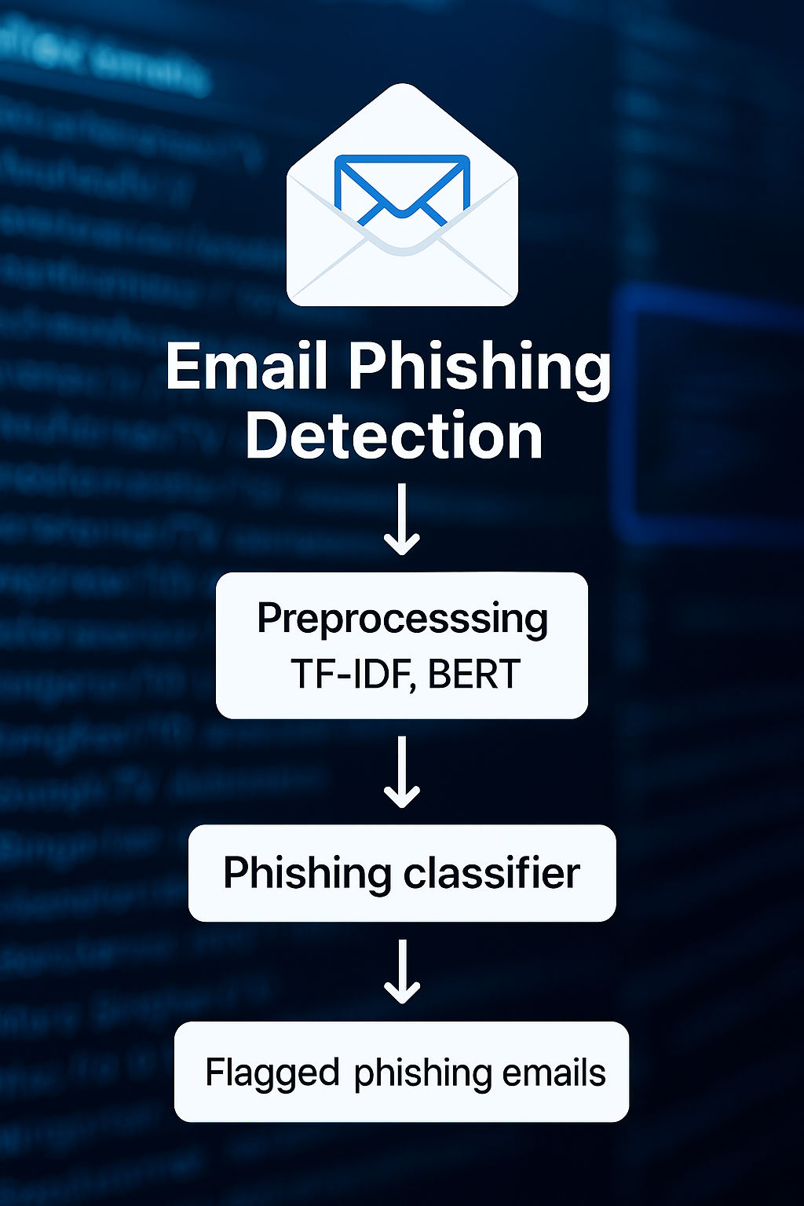
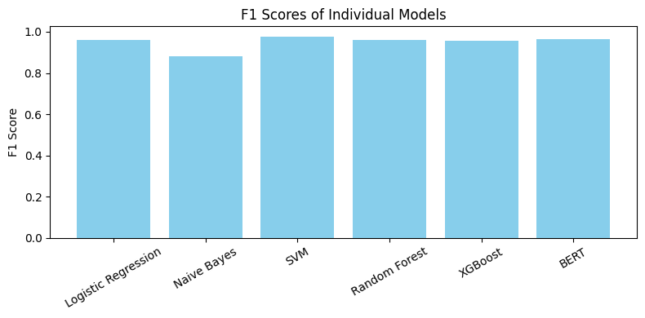
Email Phishing Detection
Pipeline
Preprocessing
Models
Cleaning text(punctuation, stopwords), TF-IDF vectorization, BERT tokenization
Logistic Regression, Naive Bayes, SVM, Random Forest, XGBoost, BERT
Notes:
Insert preprocess code image

Slide 7
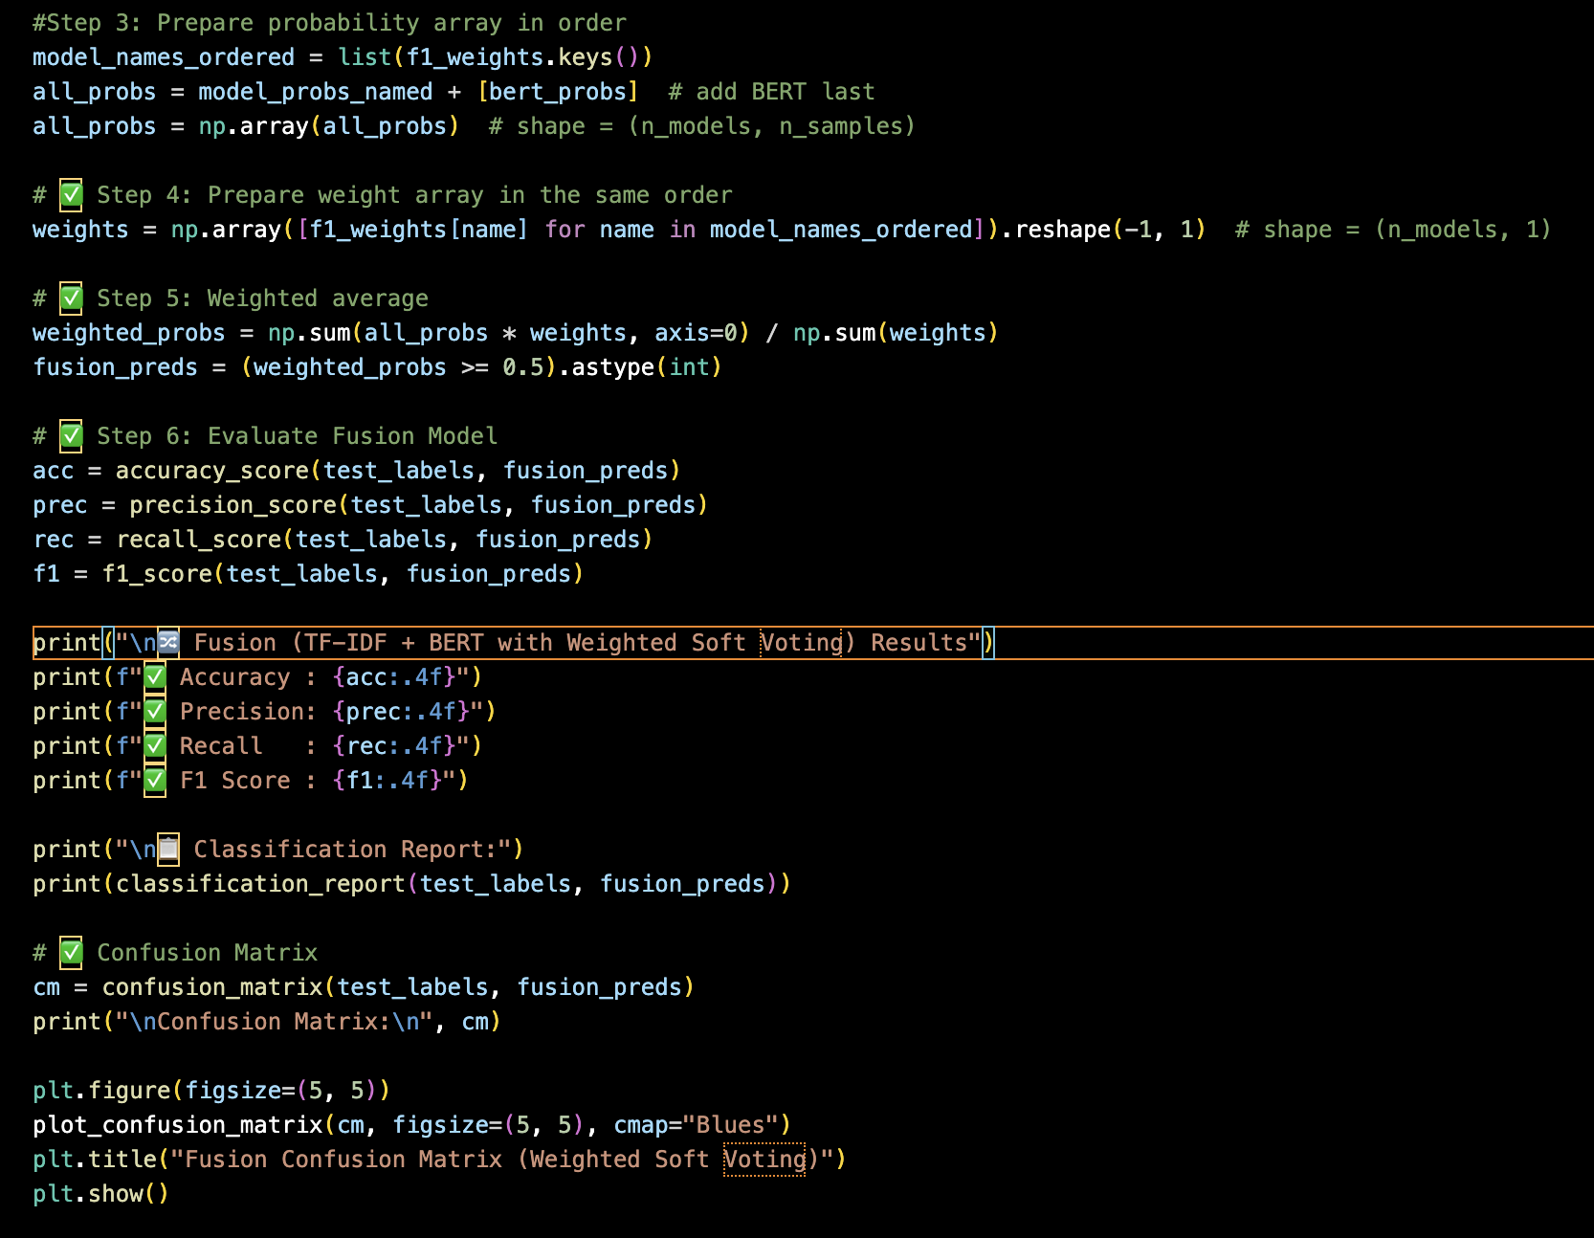
Fusion Model (based on probabilities)
Weighted soft voting based on F1 scores
Combined 5 traditional ML models + BERT.
Each model’s F1-score is used as its voting weight.
Predictions are merged using a weighted average of probabilities (soft voting).
The final label is predicted if the average probability ≥ 0.5.
Results include Accuracy, Precision, Recall, F1-score, and a confusion matrix.

Slide 8
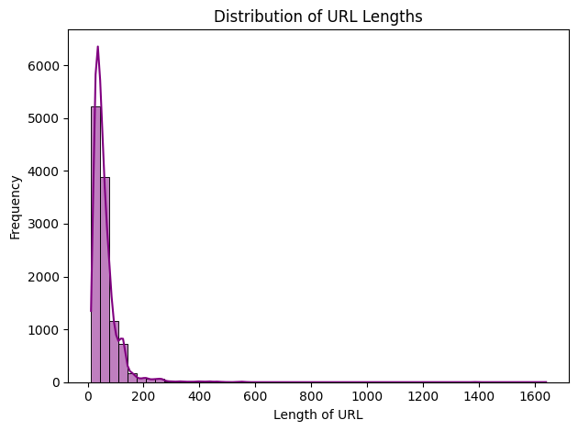
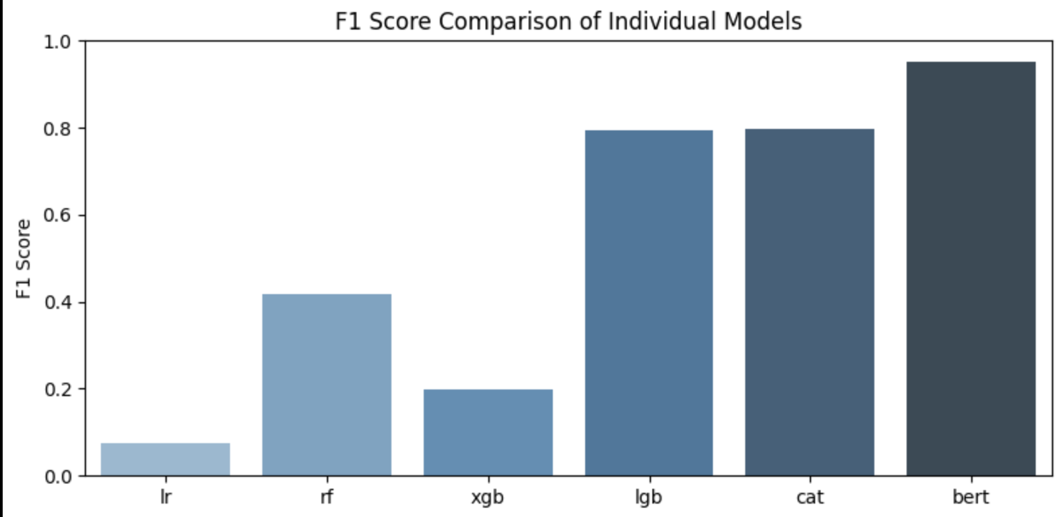
URL Phishing Detection Pipeline
Feature Engineering
URL length, digit count, number of special characters
Number of dots, hyphens, slashes
Domain-based features using tldextract
Models
Logistic Regression, Random Forest, XGBoost
BERT for semantic patterns
Fusion
Combined predictions using F1-score weighted soft voting
Balanced both structural (manual features) and semantic (BERT) signals

Slide 9
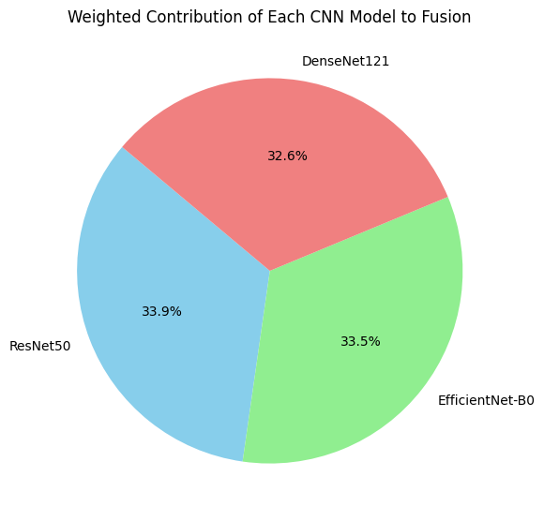
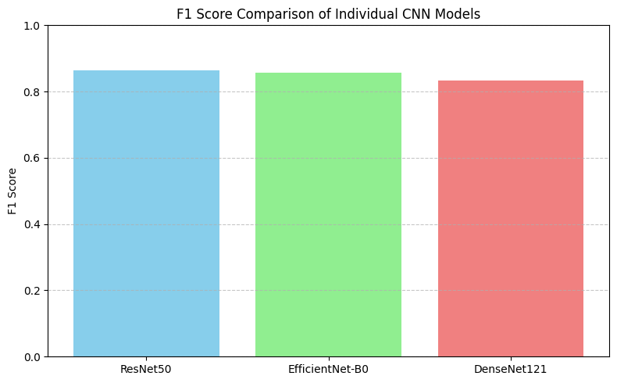
Image Phishing Detection Pipeline
Preprocessing
Resize to 224x224, normalize, augment images.
Fusion
Models
Combined predictions using
F1-score weighted soft voting.
Pretrained CNNs: ResNet50, EfficientNet-B0, DenseNet121.

Slide 10
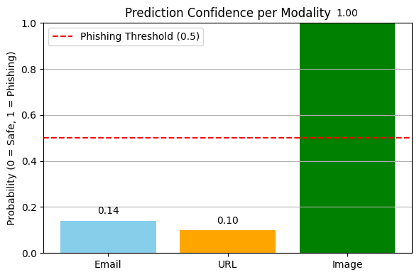
Key Results & Evaluation
Model Type
Accuracy
Precision
Recall
F1 Score
Email Fusion
0.9876
0.9861
0.9806
0.9833
URL Fusion
0.9409
0.9648
0.9152
0.9393
Image Fusion
0.8973
0.7822
0.9796
0.8699

Slide 11
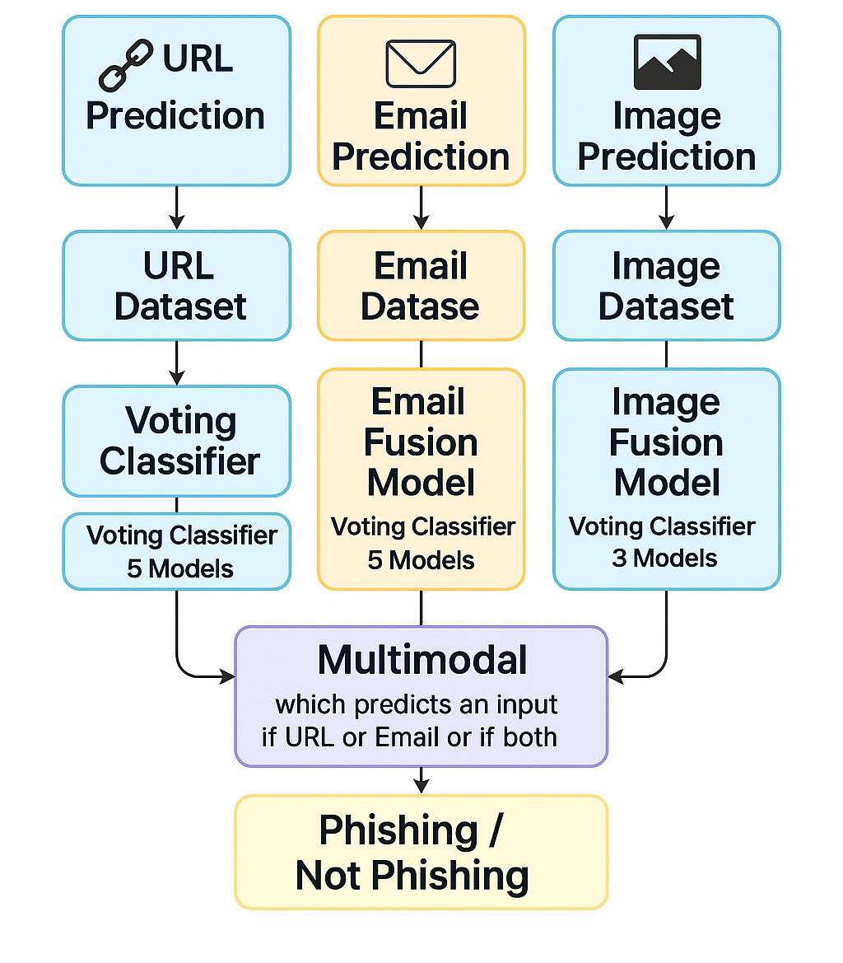
Multimodal Fusion System
Model Predictions
Combines email, URL, and image model outputs.
Voting Methods
Uses majority (hard) or weighted (soft) voting.
Flexibility
Works with any subset of inputs.
Robust Performance
Maintains accuracy and recall even with incomplete data.

Slide 12
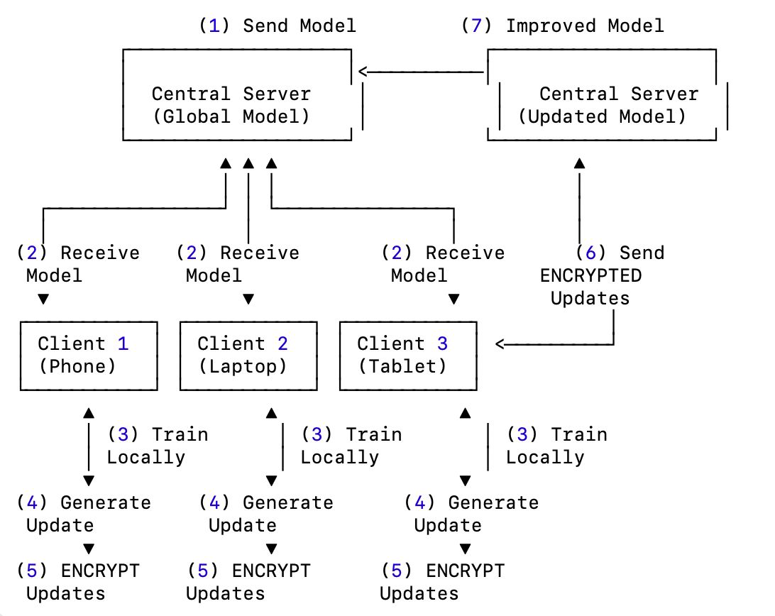
Federated Learning Architecture
Local Training
Clients train models on private data locally.
Server Aggregation
Server aggregates updates using FedAvg algorithm.
Privacy
No raw data is shared between clients and server.
Model Types
Supports traditional ML, CNN, and BERT models.

Slide 13
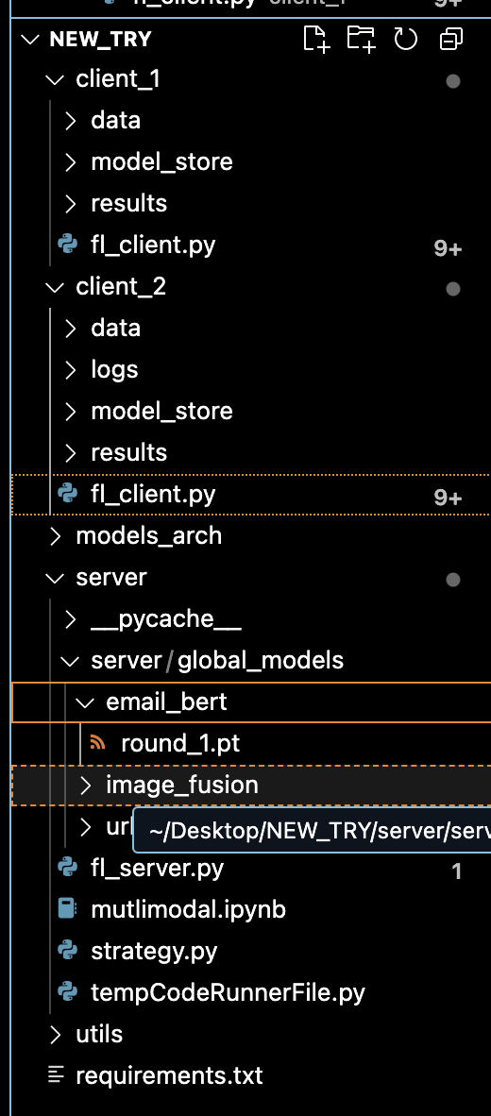
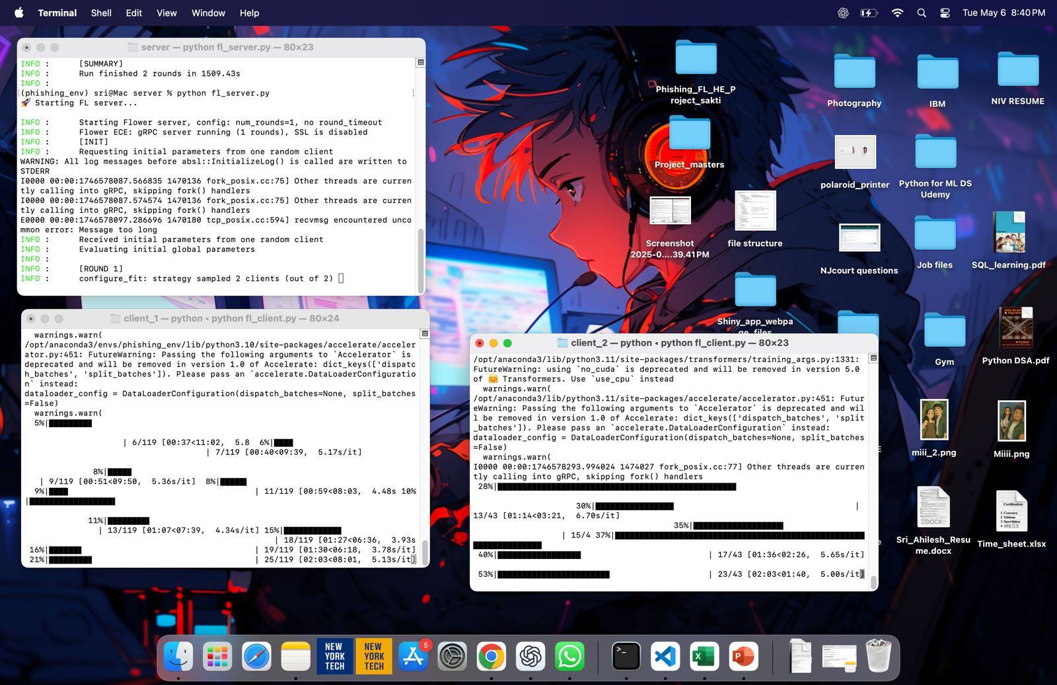
Federated Learning Working
Server
1
Central Server sends the model to all clients (devices).
Each client trains the model locally on its own data.
After training, each client generates model updates (like updated weights).
Clients send only the updates to the server.
The Central Server aggregates (averages) updates and Server updates the global model and sends back the improved model.
This improved model can be used in multimodal for detection.
Client
2

Slide 14
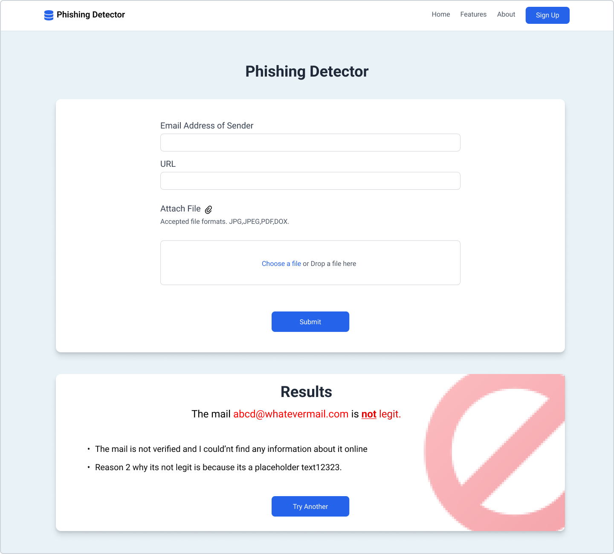
Model Storage and Deployment
Saved Models
.pkl for ML, .pt for BERT, .h5 or .pkl for CNN.
Integration Ready
Compatible with Streamlit
or Flask front-end.
Fusion Models
Separate fusion models for email, URL, and image.

Slide 15

Challenges
Limited Dataset
Small labeled data hindered model learning and accurate predictions.
Fusion Models Not Compatible with FL
Logic-based fusion models like soft or hard voting are non-trainable,
so we had to rebuild them after each server aggregation round in FL.
BERT and Traditional ML Incompatibility
BERT and traditional ML use incompatible input formats, so we combined their predictions
only at the probability level.
Different Model Output Formats
Different output formats from traditional, PyTorch, and BERT models required custom conversion logic before fusion.

Slide 16

Future Works & Discussion
Multi-Modal Integration
Incorporate SMS, chat logs, and user behavior data for comprehensive detection.
Edge Deployment
Future versions of our model can be deployed on edge devices like phones or secure gateways to detect phishing locally.
Real-Time Auto Blocking
Detect and block phishing threats instantly to prevent harm.
Advanced Federated Learning
Use similar model architectures for efficient weight aggregation.
Scale to multiple real clients across devices and networks.
Incorporate homomorphic encryption for encrypted client updates.

Slide 17

Conclusion
This project presents a comprehensive AI-powered phishing detection system that combines Email, URL, and Image-based analysis using Multimodal Learning and Federated Learning (FL).
We successfully:
Trained models across different data types (text, URL, image) using state-of-the-art ML and DL techniques.
Built fusion models to combine the strengths of traditional and deep learning approaches.
Implemented a federated learning prototype, simulating real-world decentralized training across multiple clients.
Our solution demonstrates how intelligent systems can adapt to evolving cyber threats while preserving user data privacy — marking a step toward privacy-preserving, distributed AI security systems.

Slide 18
Contribution
Sri Sakticharan Nirmalkumar
• Conducted model training and evaluation for image-based phishing detection.
• Led training and evaluation for URL-based models.
• Implemented the Federated Learning architecture.
• Developed the fusion logic for URL models.
Saptharish Golagani
• Led model training and evaluation for email-based phishing detection.
• Designed and integrated the multimodal phishing detection system.
• Implemented fusion logic for email models.
• Drafted the final project report and proposed the original project idea.
Shruthi Manchappanahalli Basavaraj
• Handled preprocessing for email and URL datasets.
• Developed the image fusion model.
• Created and designed the PowerPoint presentation.
Siva Satya Dheeraj Varma
• Collected and organized phishing datasets for email and image modalities and also Performed image preprocessing.

Slide 19
References
1. Evaluation of Federated Learning in Phishing Email Detection
https://www.mdpi.com/1424-8220/23/9/4346
2. Privacy-Preserving Phishing Email Detection Based on Federated Learning and LSTM
https://arxiv.org/abs/2110.06025v1
3. Privacy-Preserving Federated Learning Using Homomorphic Encryption
https://www.semanticscholar.org/paper/Privacy-Preserving-Federated-Learning-Using-Park-Lim/91802f60f8e9c0b746b5f16efc08f6ed112662df
4. Security for Data Privacy in Federated Learning with CUDA-Accelerated Homomorphic Encryption in XGBoost.
https://developer.nvidia.com/blog/security-for-data-privacy-in-federated-learning-with-cuda-accelerated-homomorphic-encryption-in-xgboost/
5. Fake News Classification using Weighted Soft Voting
https://www.mdpi.com/2227-7390/13/3/449
6. Weighted Voting in Anaemia Diagnosis
https://link.springer.com/chapter/10.1007/978-3-031-41352-0_18

Slide 20

Thank You

